Slide 1
Final Presentation Audio Player
Rene Moise Kwibuka Emmanuel Taylor Dufitumukiza
12/13/2016

Slide 2
Contents
Structural Context Diagram
Uses cases
Sequences Diagrams
StateChart
Dynamic Analysis Model

Slide 3
System Context Diagram
It will portray the relationship between our system and external blocks
External blocks: -Speakers
-Observer/Listener
-Thumb drive

Slide 4
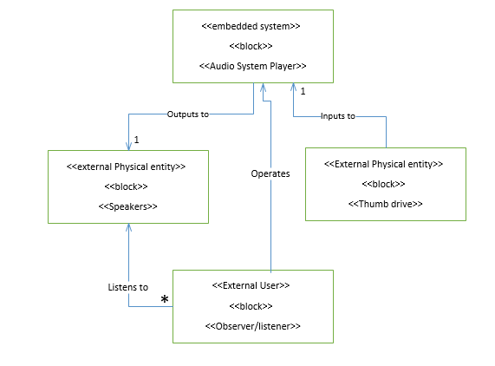
System Context Diagram

Slide 5
Uses
Uses cases will capture the functional requirements of the system.
Uses cases:
- Play song
- Pause Song
- PlayNextSong
-PlayPreviousSong
-Exit

Slide 6
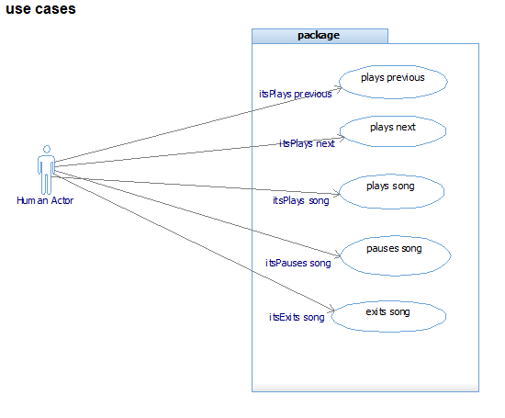
Uses Cases

Slide 7
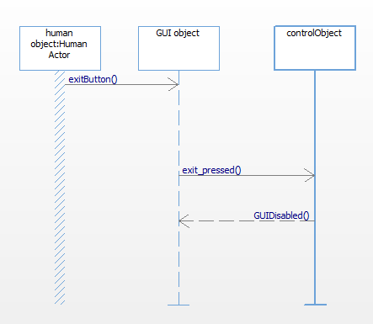
Sequence Diagrams (⅕)
ExitSequenceDiagram

Slide 8
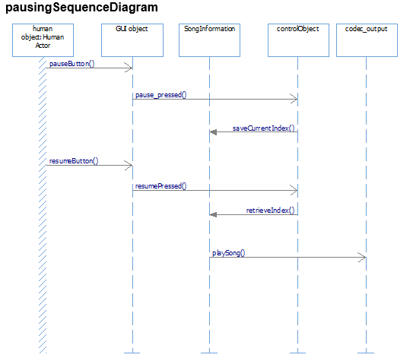
Sequence Diagram (⅖)

Slide 9
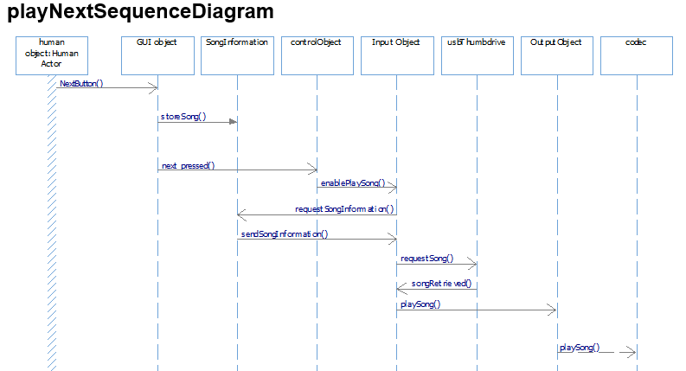
Sequence Diagrams (⅗ )

Slide 10
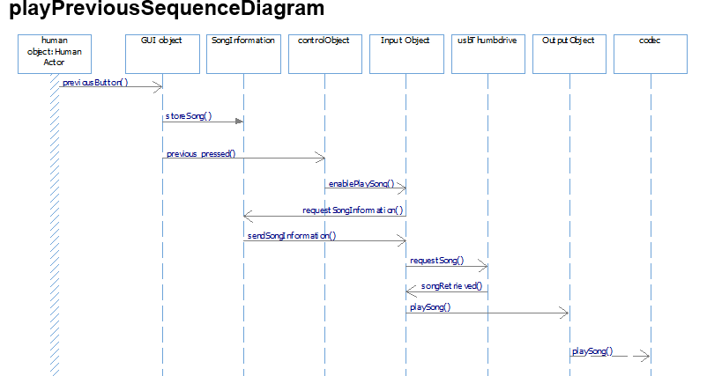
Sequence Diagram(⅘)

Slide 11
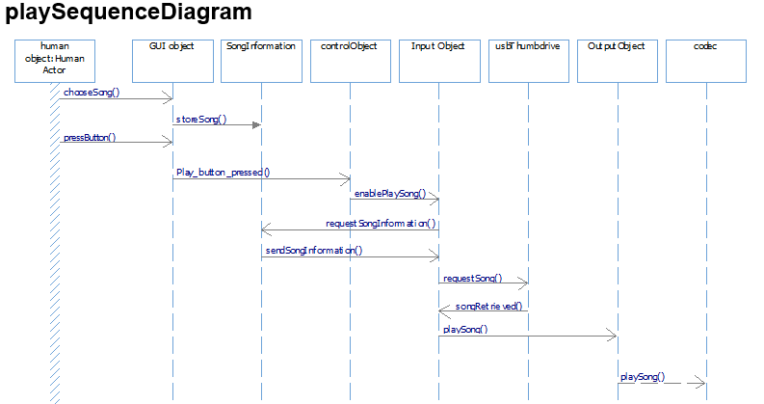
Sequence Diagram(5/5)

Slide 12
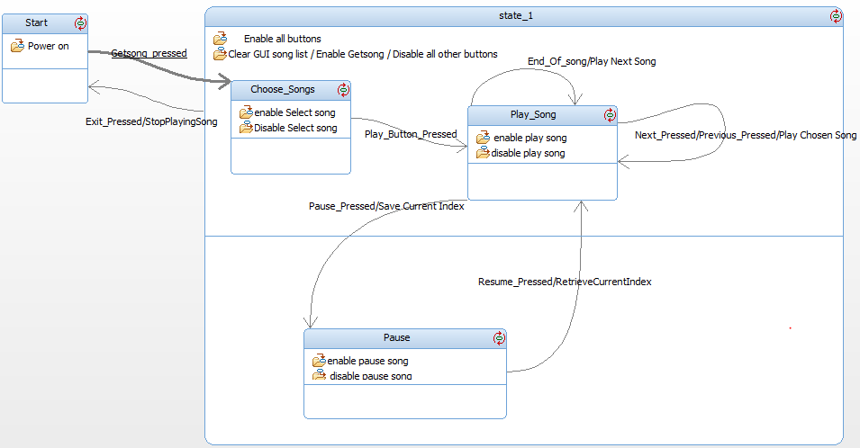
Statechart

Slide 13
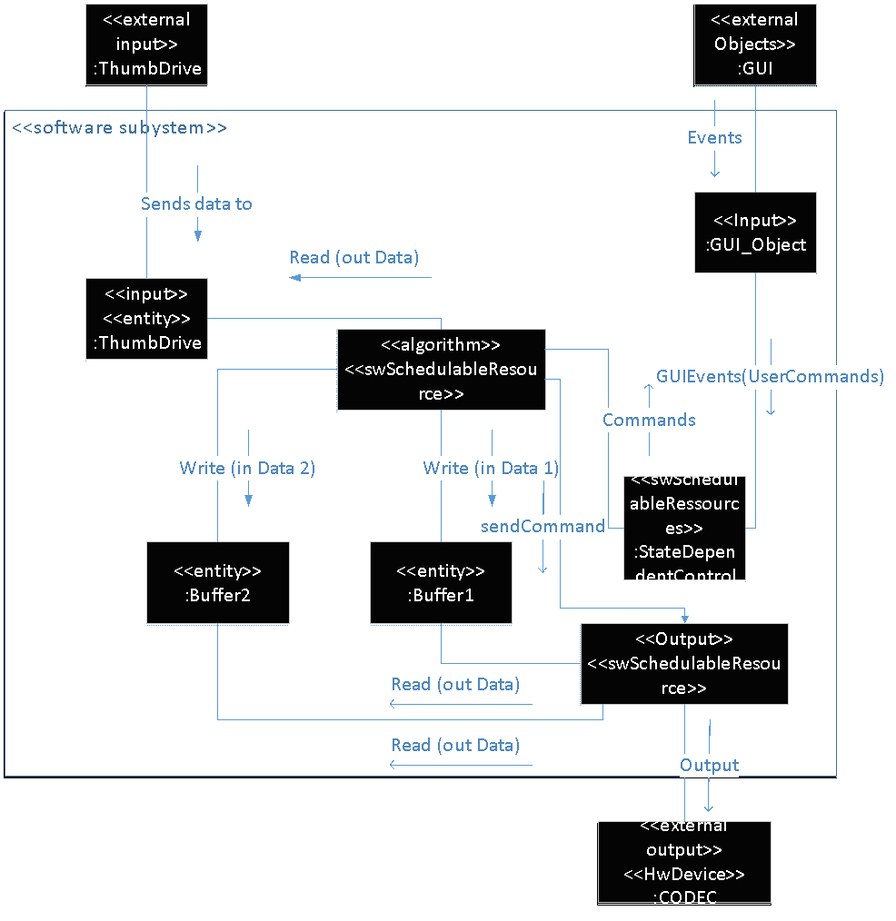
Dynamic Analysis Model

Slide 14
DEMO

